Slide 1




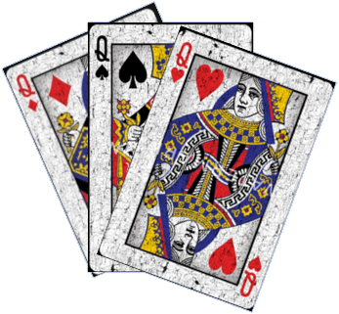
Account Login
Black Queen Bonanza
Username:
player1@gmail.com
Password:
************
Login
EXIT

Slide 2
Player1
Black Queen Bonanza
Create a game
Join a game
Select a game.
EXIT

Slide 3
Player1
Black Queen Bonanza
Enter the invite URL:
Game PIN:
******
Enter your bid points:
75
Join the game
EXIT

Slide 4
Player1
Black Queen Bonanza
Enter the invite URL:
Please wait, as other players are still bidding their points. Game will start soon….
Game PIN:
******
Continue
Enter your bid points:
75
Join the game
EXIT

Slide 5
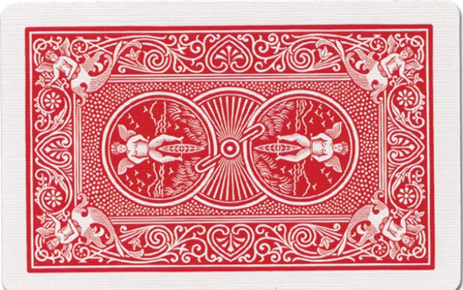
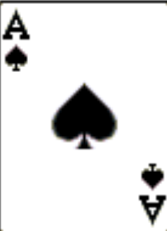
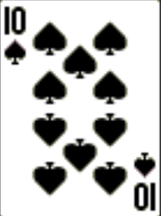
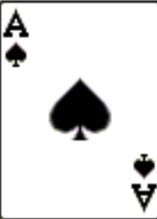
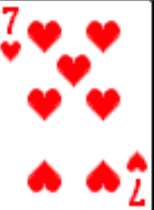
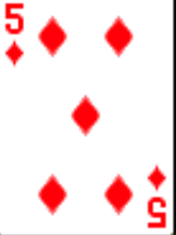
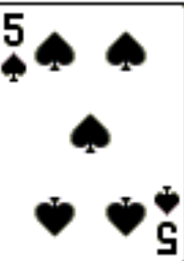
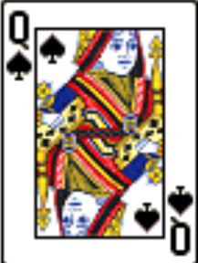
Black Queen Bonanza – Round 1
Player1
Player4
SCOREBOARD
SCOREBOARD
Players | Bid points | Round 1 | Round 2 | Round 3 | Round 4 | Total Points
Player1 | 150 (Highest)
Player2 | 75
Player3 | 0
Player4 | 90
Player5 | 0
Player6 | 75
Player5
Player3
Player6
Start a new game
Player2
Start the game
Player1
EXIT

Slide 6
Black Queen Bonanza – Round 1
Player1
Player4
Player1 as you are the highest bidder, please select a trump for round 1. Click continue to move forward.
Player5
Spades
Hearts
Diamonds
Club
Player3
Continue
Player6
Player2
Player1
EXIT

Slide 7
Black Queen Bonanza – Round 1
Player1
Player4
Next, please select two cards from the deck to chose your partners. Click continue to move forward.
Player5
Ace of spades
Queen of spades
Player3
Continue
Player6
Player2
Player1
EXIT

Slide 8
Black Queen Bonanza – Round 1
Player1
Player4
Player1 has selected the following options:
Trump: Spades
Partner Cards:
Ace of spades
Queen of spades
Player5
Player3
Player6
Player2
Player1
EXIT

Slide 9
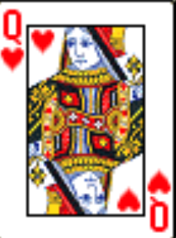
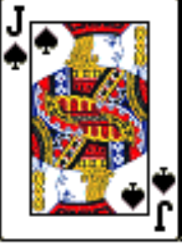
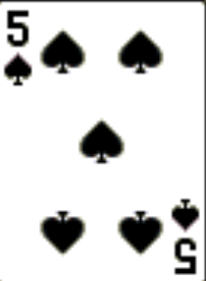
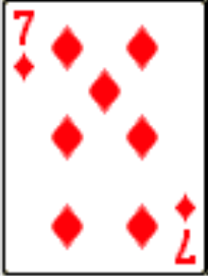
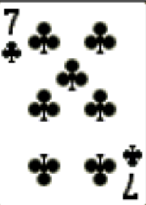
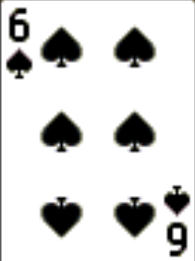
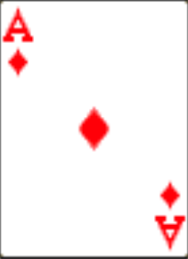
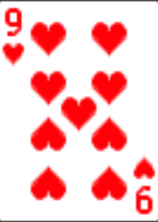
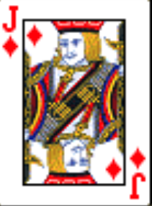
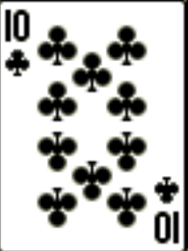

Black Queen Bonanza – Round 1
Player1
Player4
Player5
Player 1, please play the card.
Player3
Player6
Player2
Player1
EXIT

Slide 10
Black Queen Bonanza – Round 1
Player1
Player4
Player5
Player3
Player6
Player2
Player1
EXIT

Slide 11
Black Queen Bonanza – Round 1
Player1
Player4
Player5
Player 2, please play the card.
Player3
Player6
Player2
Player1
EXIT

Slide 12
Black Queen Bonanza – Round 1
Player1
Player4
Player5
Player3
Player6
Player2
Player1
EXIT

Slide 13
Black Queen Bonanza – Round 1
Player1
Player4
Player5
All players have played their cards for round 1.
Player3
Player6
Player2
Player1
EXIT

Slide 14
Black Queen Bonanza – Round 1
Player1
Player4
Player5
Round 1 is over!!!
Calculating scores….
Player3
Player6
Player2
Player1
EXIT

Slide 15
Black Queen Bonanza – Round 1
Player1
Player4
Congratulations Player1 and Player2!!
You won the round 1.
Player5
Player3
View Scores
Player6
Player2
Player1
EXIT

Slide 16
Black Queen Bonanza – Round 1
Player1
Player4
SCOREBOARD
Players | Bid points | Round 1 | Round 2 | Round 3 | Round 4 | Total Points
Player1 | 150 | 150
Player2 | 75 | 150
Player3 | 0 | 0
Player4 | 90 | 90
Player5 | 0 | 0
Player6 | 75 | -75
Player5
Player3
Player6
Start Next Round
Player2
Player1
EXIT

Slide 17
Black Queen Bonanza – Round 4
Player1
Player4
Player5
All rounds completed. Calculating final scores…
Player3
Player6
Player2
Player1
EXIT

Slide 18
Black Queen Bonanza – Round 4
Player1
Player4
SCOREBOARD
Players | Bid points (Round 4) | Round 1 | Round 2 | Round 3 | Round 4 | Total Points
Player1 | 150 | 150 | 75 | 150 | 0 | 375
Player2 | 75 | 150 | 0 | 150 | 75 | 375
Player3 | 0 | 0 | 90 | 0 | 90 | 180
Player4 | 90 | 90 | 75 | 90 | 150 | 405
Player5 | 0 | 0 | 75 | 0 | 75 | 150
Player6 | 75 | -75 | 150 | 0 | 75 | 150
Player5
Player3
Player6
Congratulations Player4, you are the winner!!!
Player2
Start a new game
Player1
EXIT

